Slide 1
Internet Tools and Technology

Slide 2

CSS
Java script
.

Slide 3
CSS
CSS stands for Cascading Style Sheet.
To apply style on HTML tags.
.

Slide 4
Syntax
A CSS rule set contains a selector and a declaration block.
Selector{Property1: value1; Property2: value2; ..........;}
H1{color: yellow; margin-left: 80px;}
.

Slide 5
Types of CSS
Inline CSS
Internal CSS
External CSS
Imported CSS
.

Slide 6
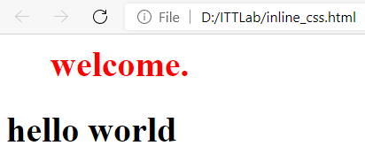
Inline CSS
<html>
<body>
<h1 style="color:red;margin-left:40px;">welcome.</h1>
<h1 >hello world</h1>
</body>
</html>
.

Slide 7
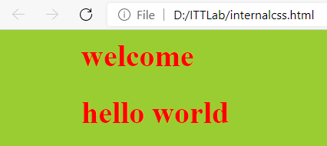
Internal CSS
<html>
<head>
<style>
body { background-color: yellowgreen; }
h1 { color: red; margin-left: 80px; }
</style>
</head>
<body>
<h1>welcome</h1>
<h1>hello world</h1>
</body>
</html>
.

Slide 8
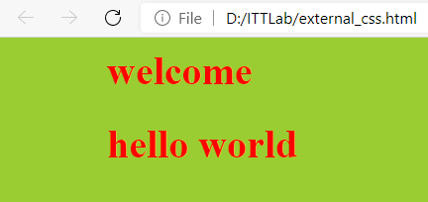
External CSS
<html>
<head>
<link rel="stylesheet" type="text/css" href="mystyle.css">
</head>
<body>
<h1>welcome</h1>
<h1>hello world</h1>
</body>
</html>
File : mystyle.css
body { background-color:yellowgreen; }
h1 { color: red; margin-left: 80px; }
.

Slide 9

Imported CSS
<html>
<head>
<link rel="stylesheet" type="text/css" href="mystyle2.css">
</head>
<body>
<h1>welcome</h1>
<h1>hello world</h1>
<h2>hello world</h2>
</body>
</html>
File : mystyle.css
File : mystyle2.css
@import "mystyle.css";
h2 { color: blue; margin-left: 80px; }
body { background-color:yellowgreen; }
h1 { color: red; margin-left: 80px; }
.

Slide 10
Java Script
Java script is a client side scripting language.
Used to create interactive and dynamic web page
Enhance appearance and functionality of web page.
JavaScript are run by an interpreter built in the web browser
.

Slide 11
Java Script
Performing simple computations on the client side
Validating the user's input
.

Slide 12
Java Script
Syntax:
<script type="text/javascript">
JavaScript code
</script>
<html>
<body>
<script type="text/javascript">
document.write("welcome");
</script>
<h1>hello world</h1>
</body>
</html>
.

Slide 13
How to specify JavaScript code
Embedded scripts
Embed JavaScript code in an HTML document
<script type=“text/javascript”>
document.writeln( “hello” );
</script>
Inserting external scripts
Insert a file with “.js” extension that contains JavaScript code
<script type=“text/javascript” src=“external.js” />
.

Slide 14
Data Types
Numbers, eg. 123, 120.50 etc.
Strings of text e.g. "This text string" etc.
Boolean e.g. true or false.
Variable Declaration
var name = "Ali";
var money;
money = 2000.50;
.

Slide 15
Some of the Java Script String Methods
charAt(pos)
split()
concat()
indexOf()
substring()
substr()
var str = "HELLO WORLD";
str.charAt(0);
var str = "How are you doing today?";
var res = str.split(" ");
var txt = “manipal";
var l = txt.length
Length property to find length of a string
.

Slide 16
Array
var array_name = [item1, item2, item3];
var ages = [3, 10, 18, 20];
var fruits = ["Banana", "Orange", "Apple", "Mango"];
<html>
<body>
<script type="text/javascript">
a= [10,20,30,40,50]
for(i=0;i<5;i++)
document.write(" ",a[i]);
</script>
<h1>hello world</h1>
</body>
</html>
.

Slide 17
Some of the Java Script array Methods
var hege = ["Cecilie", "Lone"];
var stale = ["Emil", "Tobias", "Linus"];
var children = hege.concat(stale);
concat()
indexOf()
join()
lastIndexOf()
sort()
.

Slide 18
Object
var object_name = {variable, method}
var point = { x:10, y:20}
<html>
<body>
<script type="text/javascript">
var point = { x:10, y:20}
document.write(point.x," ",point.y);
</script>
<h1>hello world</h1>
</body>
</html>
.

Slide 19
Operators
Arithmetic operator : +,-,*,/,%
Relational operator : <, >,<=,>=,==,!=
Logical operator : &&,||,!
Compound assignment operators: +=,-=,*= etc
Increment and decrement operators : ++,, --
<html>
<body>
<script type="text/javascript">
var a=2,b=3
document.write(a+b);
</script>
<h1>hello world</h1>
</body>
</html>
.

Slide 20
Control Structures
Selection structure
if
if…else
switch
Repetition structure
while
do…while
For
break and continue statement
<html>
<body>
<script type="text/javascript">
for(i=1;i<=5;i++)
document.write(i);
</script>
<h1>hello world</h1>
</body>
</html>
.

Slide 21
Java script function
html>
<head>
<script type="text/javascript">
function sum(n)
{ var s=0;
for(i=1;i<=n;i++)
s=s+i;
return s; }
</script>
</head>
<body>
<script type="text/javascript">
document.write("sum =",sum(5));
</script>
<h1>hello world</h1>
</body>
</html>
Syntax:
<script type="text/javascript">
function functionname(parameter-list)
{
statements
}
</script>
.

Slide 22
Document Object Model
When a web page is loaded, the browser creates a Document Object Model of the page
With HTML DOM, JavaScript can access and change all the HTML elements/HTML attributes / CSS styles in the page
Provides set of methods/property to access html elements
<body>
<p id="p2“></p> <script>
document.getElementById("p2").innerHTML = “Welcome to ICT "; document.getElementById("p2").style.color = "blue"; </script> </body>
.

Slide 23
<html>
<body>
<div id="p2"></div>
<script>
var flag=0; col="red", t="MIT";
function disp()
{
document.getElementById("p2").style.color = col;
document.getElementById("p2").style.fontSize = 20;
document.getElementById("p2").innerHTML = t;
if(flag==0)
{ flag=1;
col="blue";
t="ICT; }
else
{ flag=0;
col="red";
t="MIT"; }
setTimeout(disp,1000);
}
disp();
</script>
</body>
</html>
.

Slide 24
.

